Slide 1
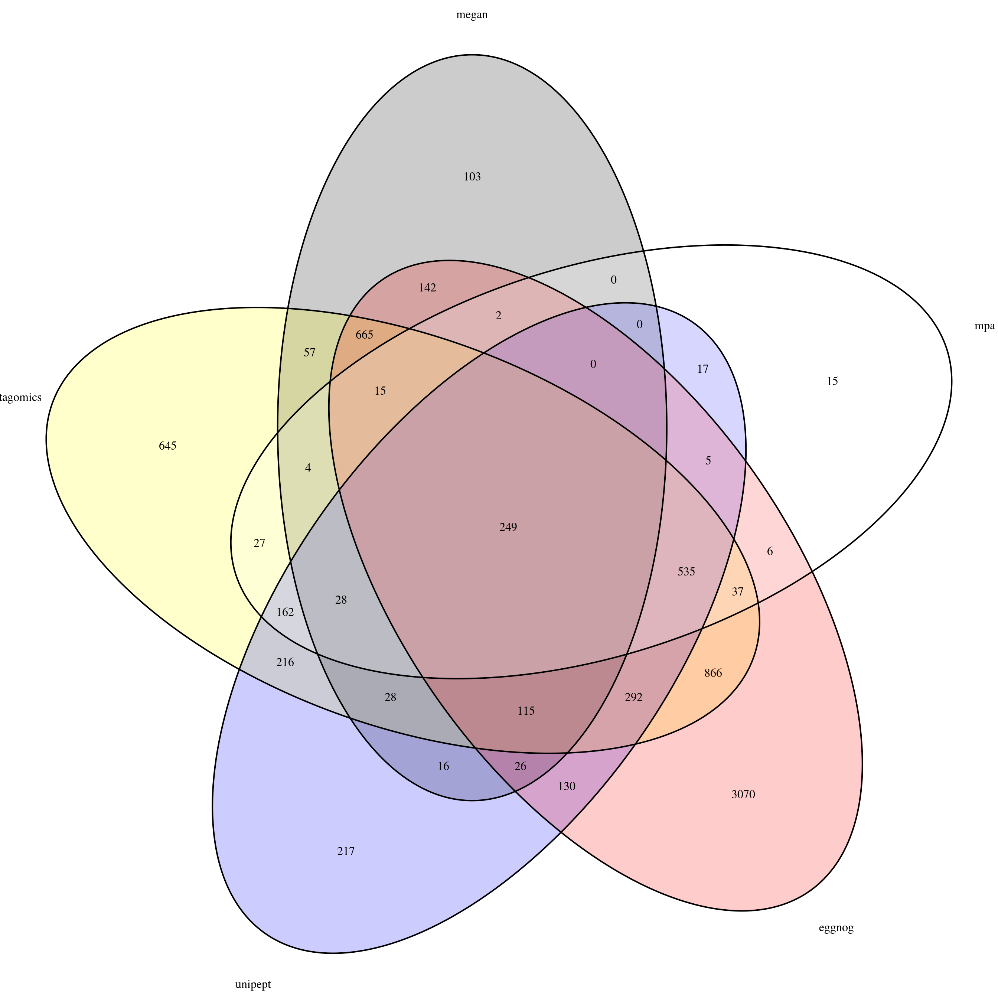
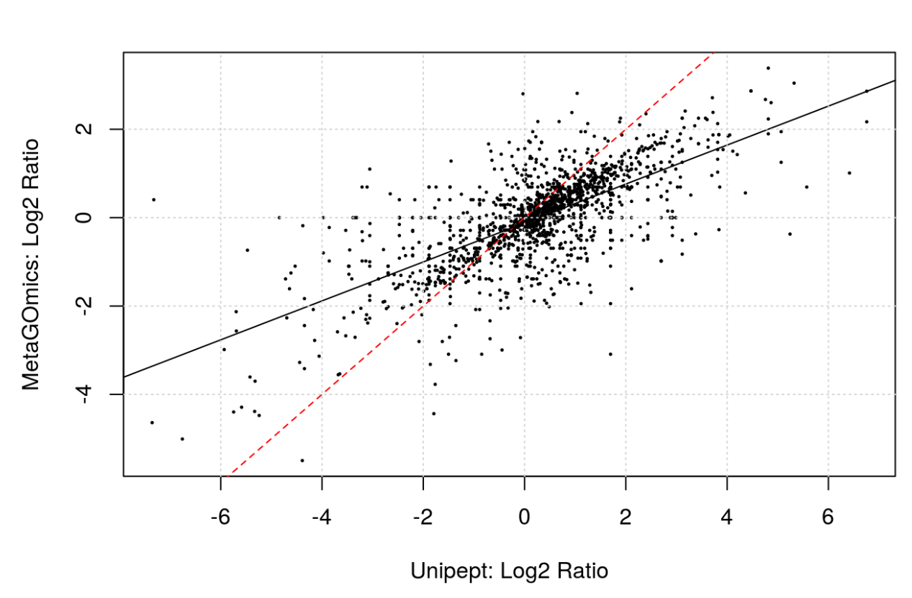
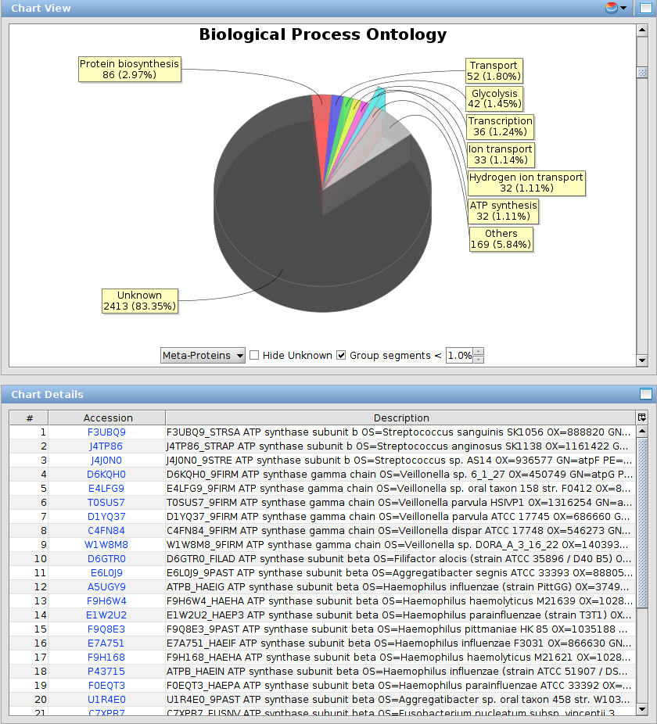

Unravelling The Functions of Microbiomes: A Comprehensive Evaluation of Sotware Tools for Functional Metaproteomics
Caleb Easterly¹; Carolin Kolmeder²; Thilo Muth³; Bart Mesuere⁴; Subina Mehta¹; Praveen Kumar¹; James Johnson¹, Shane Hubler¹ , Jaime Huerta-Cepas⁴, Bjoern Gruening; Michael Riffle; Damon May; W. Judson Hervey; Alessando Tanca; Brook L Nunn; Joel Rudney; Timothy J. Griffin; Pratik D Jagtap
¹ Center for Mass Spectrometry and Proteomics, UMN, St. Paul, MN; ² Biochem. Mol Biol. Biophysics, University of Minnesota, Minneapolis, MN; ³ Advanced Clinical Biosystems Research Institute, Los Angeles, CA; ⁴ University of Freiburg, Freiburg, Germany;
⁵La Trobe University, Melbourne, Australia; ⁶Minnesota Supercomputing Institute, UMN, Minneapolis, MN; ⁷ Department of Biology, IMSB, ETH Zurich, Zurich, Switzerland; ⁸Faculty of Science, University of Zurich, Zurich, Switzerland
INTRODUCTION
IDENTIFICATION STATISTICS and OVERLAP
REPRODUCIBILITY
FEATURES (CHECK LIST)
Need some way to understand complicated metaproteomics data
How do we understand differences in processes that microbiome is carrying out?
- In single organism proteomics, would do differential expression
- This is difficult in metaproteomics due to exacerbated protein inference problem (peptides may be homologous to proteins from multiple organisms)
Several established functional analysis tools focus on single organisms (DAVID and the GO term enrichment service, for example).
Functional analysis tools offer a variety of ways of understanding the function of a microbiome
Peptide-centric
Protein-centric
Ontology-centric
CONCLUSIONS
DATASET FOR FUNCTIONAL ANALYSIS
OVEREXPRESSED PROTEIN LIST (TOP 5)
QUANTITATION
INPUTS FOR EACH SOFTWARE TOOL
 | Spectral Counts | MS1 Intensities
Single sample | Unipept MetaProteomeAnalyzer
Multiple samples | MetaGOmics MEGAN | eggNOG mapper
https://docs.google.com/spreadsheets/d/1z9Rm9sgvScEUlB9D6YdA1wt2-ba7zcCo3inLGZFd3yY/edit?usp=sharing
TOOLS and METHODS USED FOR FUNCTIONAL ANALYSIS
VISUALIZATION
We compared several functional analysis tools on the basis of the following metrics:
Qualitative (refer to this spreadsheet)
different ontologies available within the tools ability to leverage quantitative information
visualization of datasets reproducibility, ease of use, and availability.
Quantitative
number of peptides that were mapped to functional groups and gene ontology terms
Overlap between GO terms for those that use them (eggNOG mapper, metaGOmics,
maybe more)
biological conclusions drawn from data
Overlap between OGs (MEGAN and eggNOG mapper)
Comparison of differentially expressed GO terms / other functional terms
For metaGOmics and Unipept, comparison of ratios for shared GO terms
Choose a few processes/terms and see how the fold changes compare across tools
GalaxyP is supported through the NSF Grant # and NCI…
EggNOG Mapper
MEgaN
METAGOMICS
METAPROTEOME ANALYZER
UNIPEPT

